Slide 1
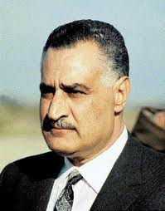
Reign of Gamal Abdel Nasser
Raya, Alaa, Ranna

Slide 2
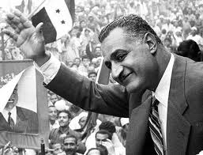
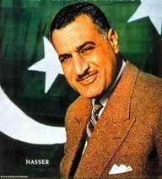
Second president of Egypt from 1956-1970
born January 15, 1918 in Bakos, Alexandria, Egypt

Slide 3
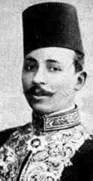
Early Life
Became involved with politics at early age
Chairman of the Young Egypt Society
Read books by famous politicians and writers
Mostafa Kamel

Slide 4
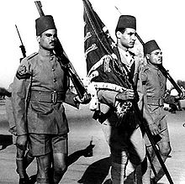
Military Career
Entered Royal Military Academy in 1937
1938, joined Egyptian Army after graduation
Became instructor in Royal Military Academy
Worked on Anti- British activities
Military Academy

Slide 5
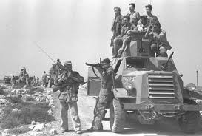
Arab-Israeli War
In 1948, he fought Arab-Israeli War
Arab countries against Israel
Loss of First War affected him
Founded Free Officers Movement in 1949

Slide 6
Goal: to overthrow Egyptian monarchy and British advisors
Egyptian Revolution of 1952: leader with Muhammad Naguib the first president
Revolution Flag

Slide 7
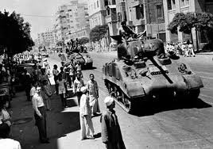
Disposed King Farouk
Made Muhammad Naguib President
November 1954-Became Prime Minister
Banned Muslim Brotherhood
Disposal of King Farouk

Slide 8
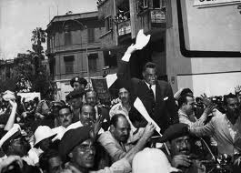
Naguib was forced to resign from position
1956, becomes President
Confiscated land from rich landowners
Nationalized Suez Canal to aid the finance of Aswan Dam on July 26, 1956
Nationalism of Suez Canal

Slide 9
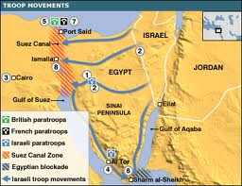
Paid off to Britain and France as they were share holders
Britain, France and Israel secretly planned an attack on Egypt
October 1956, Israeli army invaded Egypt
War of 1956

Slide 10
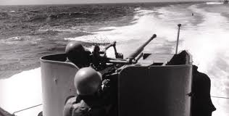
British/French/Israeli Attacks
Britain and France landed at the northern end of the Suez Canal
Most of the countries condemned these attacks
This made Britain, France, and Israel withdraw from Egypt
He blocked Suez Canal

Slide 11
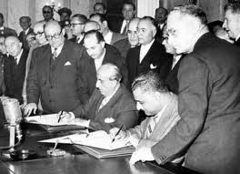
Reduced oil exports to western Europe
1958-1961 became the President of the Arab United Republic
1959- contributed to building of High Dam in Aswan
United Arab Republic

Slide 12
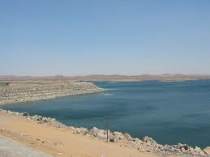
Aswan Dam
Nile River Flood so needed to build dam
US promised to contribute 56 million dollars in this project
Later refused to pay
Soviet Union helped them financially for the project

Slide 13
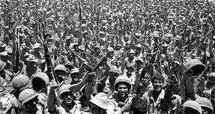
1967, Six Day War
Lost war
Resignation not accepted by people of Egypt
Six Day War

Slide 14
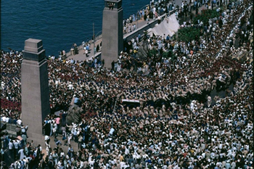
Funeral
Focused only to modernize his country
Defended Arab Nationalism and the people's right to be free.
A hero in Egypt and Arab World
Died September 28, 1970 from heart attack
National grief in Egypt

