Slide 1
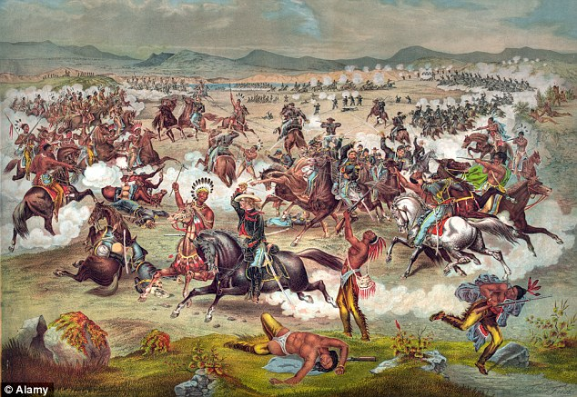
North American Warfare
By: Adam Temraz

Slide 2
Bravery
Bravery was important in tribes.
Respect was given to bravery.
Greatest sign of bravery: Coup.
Points were given for kills.
More points with coup stick.

Slide 3
Bravery
Point system used for bravery count.
All coups counted, and displayed publicly.
They had feathers on war bonnets.
Or notches on their coup stick.

Slide 4
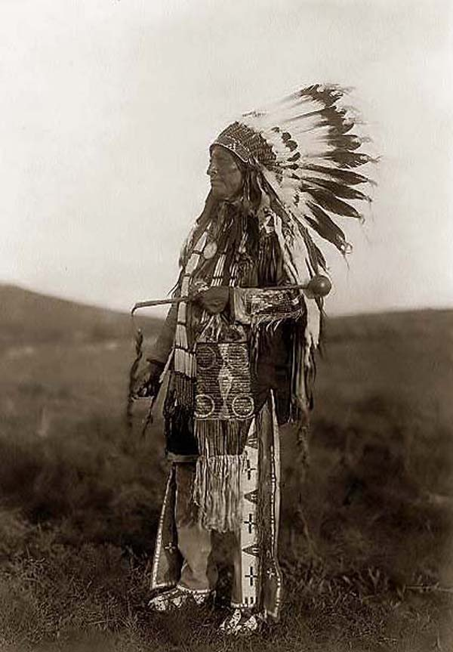
Bravery
A Sioux
warrior at the
right.
He’s holding a
Coup stick.

Slide 5
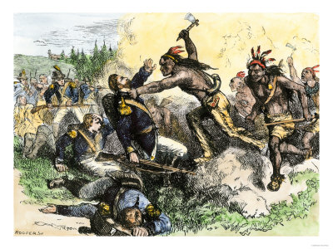
Causes of War
A chance for glory.
Someone seeking revenge.
For property.

Slide 6
Raids
Raiding added to tribal wealth.
Apaches, Comanche's, Kiowa's raided for: food, material goods, and live stock.
Also, people raided for social popularity.
Owning land boosted you in the community.

Slide 7
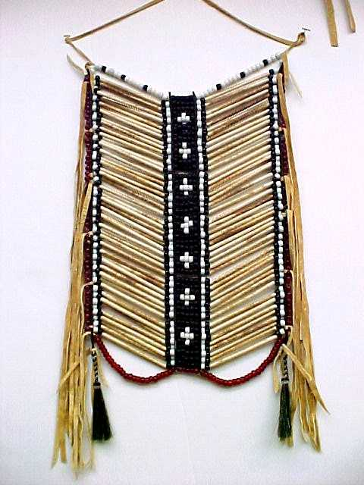
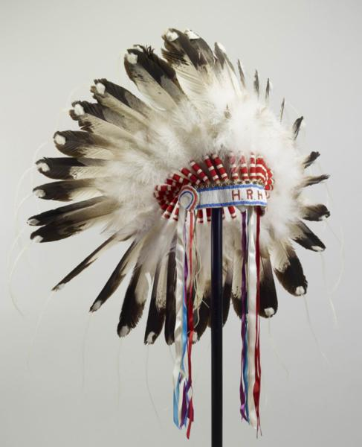
Armor
Right: Breastplate made of bones and beads
Left: Chief headress made of fur and feathers.

Slide 8
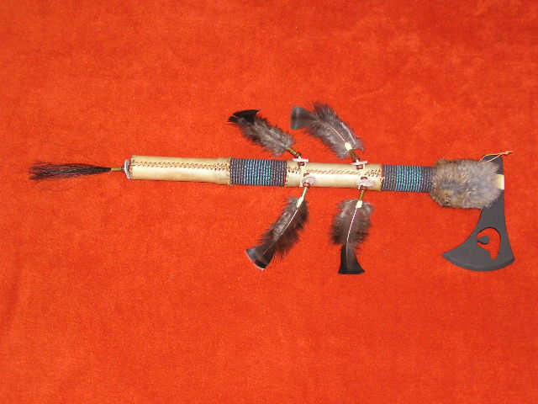
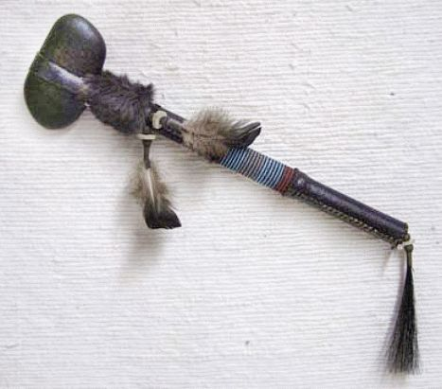
Weaponry
Tomahawks (at the right)
Blowguns (tube that fires
projectiles or darts.
Lances (spears)
Bows and arrows
War clubs (right)

Slide 9
Weapon Dance
Used in combat.
Used to reenact the moves of combat in the form of a dance.
Usually for some ceremonial purpose.
Refers to “ pyrrhic”, a weapon dance in ancient Sparta.
Modern day uses: reenactments.

Slide 10
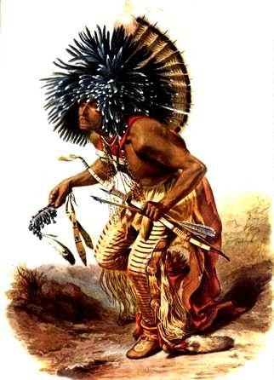
Preparation and Tactics
Rituals and advice given by the medicine man.
Preferred form of battle: sudden raids.
Average: 20-30 men would go on raids.
Women very rarely took place.
A medicine man (at the right).

Slide 11
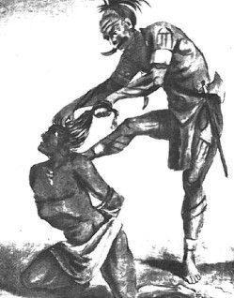
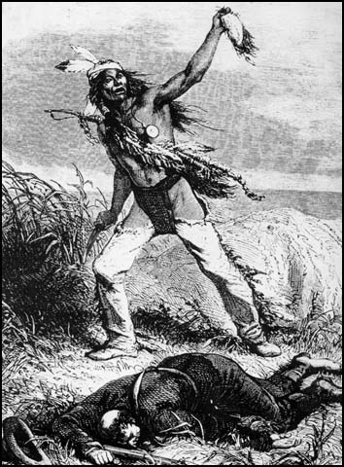
Scalping
Scalp-skin and hair on top of head.
Death on battlefield led to scalping.
W/o scalping, the Sioux believed you couldn’t enter eternal after-life.
Sioux removed scalp of enemies
It was for less enemies in after-life.

Slide 12
Bibliography
"Cherokee." ~Mountain City Elementary School. Web. 20 Mar. 2012.
http://www.mce.k12tn.net/indians/reports1/cherokee2.htm.
"Indian Weapons." Spartacus Educational. Web. 20 Mar. 2012. http://www.spartacus.schoolnet.co.uk/WWindianweapons.htm.
"Laroche Leathers - Artwork." Laroche Leathers. 12 July 2005. Web. 20 Mar. 2012.
http://www.larocheleathers.com/artwork.html.
"Native American Warfare." Schoolhistory. School History. Web. 20 Mar. 2012. http://www.schoolhistory.co.uk/year8links/natives/Nativewarfare.pdf.
"Weapon Dance." Wikipedia. Wikimedia Foundation, 17 Mar. 2012. Web. 20 Mar. 2012. http://en.wikipedia.org/wiki/Weapon_dance.

Slide 13
Bibliography (Pictures)
http://www.neokistomi.com/breastplate5.JPG
http://images.suite101.com.s3.amazonaws.com/3022001_com_headdress.jpg
http://www.old-picture.com/indians/pictures/Counting-Coup.jpg
http://www.american-indian-art.com/Tomahawk25-96.JPG
http://cache2.artprintimages.com/lrg/22/2246/JW2ZD00Z.jpg

Slide 14
Bibliography (Pictures)
http://www.red-path.org/war-clubs/Medium-Stone-Head-War-Club-lge.jpg
http://www.wendag.com/images/titans/ch50/scalp.jpg
http://www.spartacus.schoolnet.co.uk/WWscalping1.jpg
http://www.worldofstock.com/slides/PCU1415.jpg

Slide 15
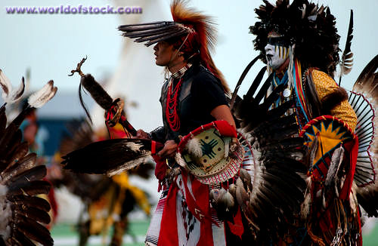
Thank you for
watching!

