Slide 1
Mayan calendar
By:Mazen el gamal

Slide 2
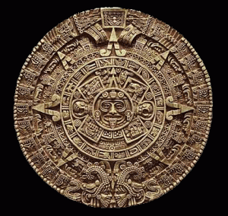
The mayan calendar is one of the calendars used in mesoamerica .

Slide 3
The using of the mayan calendar are based upon a system which had been In common use.

Slide 4
How did the maya write
The calendar was used by pictures of animals , people or objects in daily life.

Slide 5
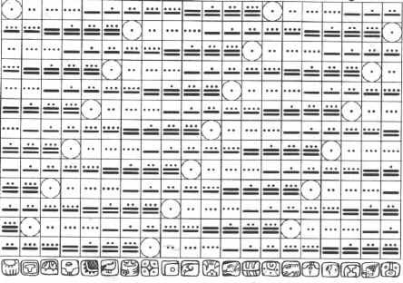
How is the Mayan calendar structured?
It is structured by the two hundred sixty day count.

Slide 6
Does the mayan calendar end in 2012?
Philip Plait, who is an astronomer , said clearly that the Mayan calendar does not end in 2012.
He gave an example , the odometer of a car as it reaches to nine , it goes back to 0 . He means that only a cycle ends in 2012 not the whole calendar.

Slide 7
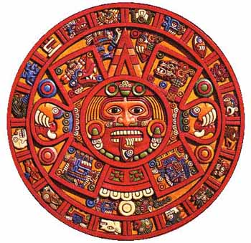
How many periods were in the mayan calendar?
The mayan calendar was divided into five periods.

Slide 8
Mayan Mathematics

Slide 9
What is the difference between our digits today and the ancient mayan digits?
The difference is that we have ten digits , while the ancient mayans had twenty base numbers

Slide 10
The numbers were written from bottom to top.
Because the base number was twenty they did not use any number more than twenty.

Slide 11
It is very easy to add or subtract in the ancient mayan mathematics.

Slide 12
Adding is just so easy, it is a matter of adding dots and bars.
Base twenty was also used in the mayan calendar.

Slide 13
Bibliography
"Maya Calendar." Wikipedia. Wikimedia Foundation, 20 Mar. 2012. Web. 20 Mar. 2012. <http://en.wikipedia.org/wiki/Maya_calendar>.
"Maya Mathematics." Michielb.nl. Web. 20 Mar. 2012. <http://www.michielb.nl/maya/math.html>.

