Slide 1
Mayan Writing, Mathematics and Astrononmy

Slide 2
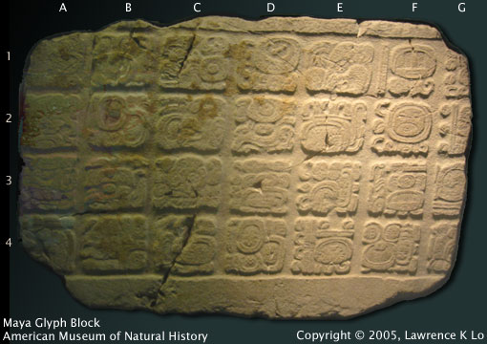
Mayan Writing

Slide 3
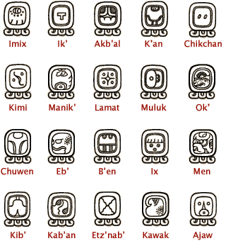
The last writing deciphered
They started 2300 years ago
Not all evidence supports that
There are about 800 signs
This is called a syllabary

Slide 4
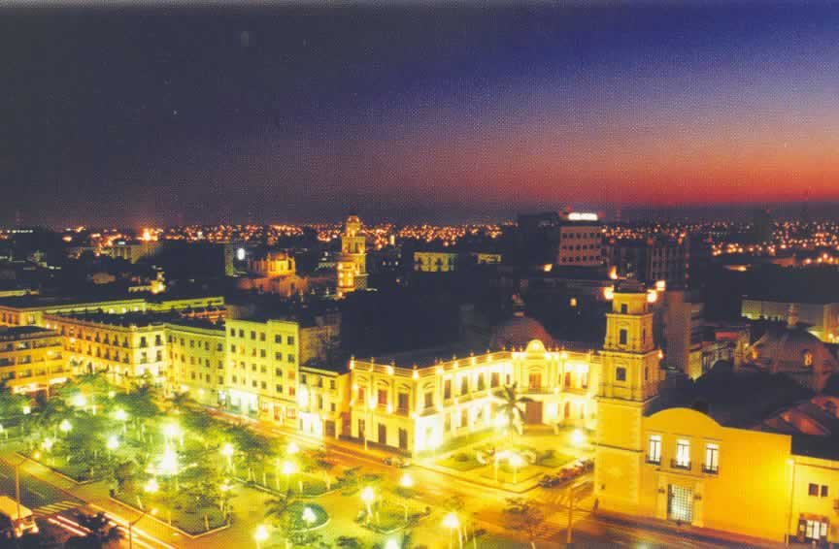
This wasn’t their own writing
Origins go back to Veracruz
The Mayans created a scripture
It was the most complex scripture

Slide 5
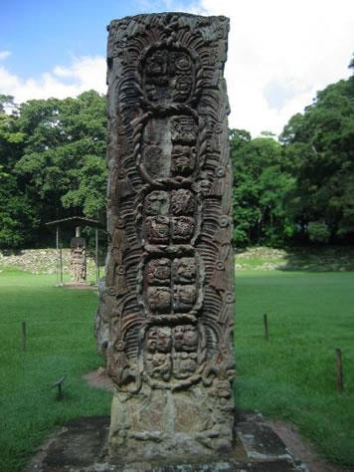
It is the first evidence of writing
But only in America
Stella's represented all the letters
Stella's contains information on rulers
They used Hieroglyphic writing

Slide 6
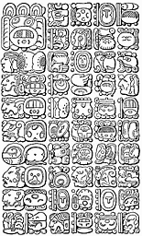
Hieroglyphics represent sounds
Mayan texts were beautifully painted
It represented a complete sentence
Blocks were the same size
Contains stuff about the rulers

Slide 7
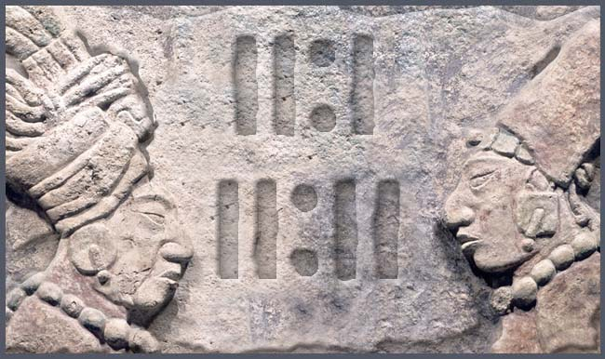
Mathematics

Slide 8
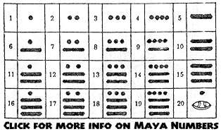
The base number was 20
System was based on signs
Read from bottom to top
A dot represents 1
A bar represents 5

Slide 9
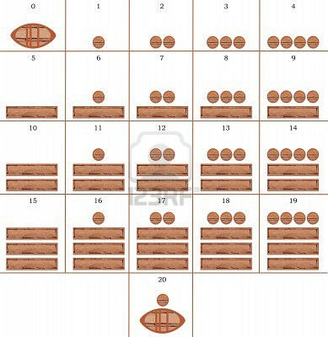
Its called a binary system
Math was used a lot
Math geniuses were a gift
Math’s used for religious purposes
They kept track of time

Slide 10
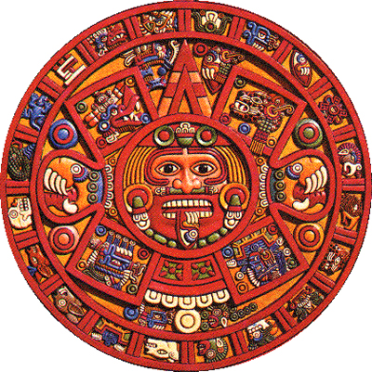
It was used for engineering
Many water reservoirs were constructed
The Mayans also had a calendar
This needs lots of math
Complex mathematical theorems helped

Slide 11
Bibliography
"Mathematics & Astronomy." Tikal, Travel to Tikal National Park in Guatemala, General Info on Tikal Tours, Transportation to Tikal, Tikal Hotels, Flights to Tikal from Belize, Cancun and Guatemala to Enjoy Tikal at Its Best and Explore Other Ancient Maya Sites. Web. 19 Mar. 2012. <http://www.tikalpark.com/mathema.htm>.
"Ancient Scripts: Maya." Ancient Scripts: Home. Web. 19 Mar. 2012. <http://www.ancientscripts.com/maya.html>.
"Maya Writing." Authentic Maya. Web. 19 Mar. 2012. <http://www.authenticmaya.com/maya_writing.htm>.
"Hieroglyphic Writting." Tikal, Travel to Tikal National Park in Guatemala, General Info on Tikal Tours, Transportation to Tikal, Tikal Hotels, Flights to Tikal from Belize, Cancun and Guatemala to Enjoy Tikal at Its Best and Explore Other Ancient Maya Sites. Web. 19 Mar. 2012. <http://www.tikalpark.com/hiero.htm>.

Slide 12
Thank you Marwan El Gamal

