Slide 1
The French Revolutions of 1830 and 1848
By: Farida and Mena

Slide 2
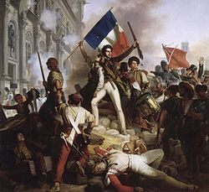
The Revolution of 1830

Slide 3
The ‘Restoration’ Era
After French Revolution
France emerged as the most liberal large state
Congress of Vienna restored Louis XVIII
Louis XVIII governed as a Constitutional monarch
Notes:
After the chaos of the French Revolution, France emerged as the most liberal large state. To resolve the many arising issues from the revolution, the Congress restored the bourbon king, Louis XVIII, as king of France. He realized that the restoration of old order was impossible so he accepted to be a constitutional monarch and gave a charter to the people.

Slide 4
LOUIS XVIII
Granted legislative power
Limited royal power
Agreed to observe the 1814 ‘Charter’ of the Restoration Era
Protected
civil rights
Upheld the Napoleon
Code
Notes:
A parliament of two Houses elected by a limited body of voters was granted. He also limited royal power, protected civil rights, and upheld the Napoleon Code. The Tricolor flag, a symbol of revolution, was ordered to be given up as a National flag. He imposed heavy censorship on press. Conditions grew worse, with the accession of Charles X to the French throne. He was highly reactionary and an ardent supporter of old regime.

Slide 5
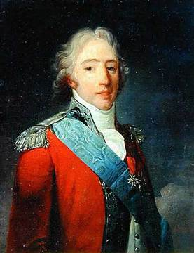
France was divided into
Those who accepted ideals of Fr. Revolution
Those who didn’t accept them
Revolutionaries
Ultra-Royalists
Their leader was
The Count of Artois (aka the future King Charles X
Notes:
At this time, France was divided into two groups: those who accepted the ideals of the Fr. Revolution, the revolutionaries, and those who didn’t the Ultra-Royalist. The Royalists, who were in a majority in the Legislature, wanted to restore monarchy to its old order. They basically wanted to act as if the revolution never happened. This group of people were lead by the Count of Artois, the younger brother of Louis XVIII and the future king Charles X.

Slide 6
The 'Ultras'
1815
1816
WHITE TERROR
Royalist mobs killed 1000s of former revolutionaries
ELECTIONS
They ‘Ultras’ were rejected in the Chamber of Deputies
1820
Louis XVIII moved gov. more to right
Changes in voting rights
Censorship imposed
MURDER
Son of Artois was murdered. Royalists blamed the left
Notes:
1815- WHITE TERROR
Royalist mobs killed 1000s of former revolutionaries
1816- ELECTIONS
They ‘Ultras’ were rejected in the Chamber of Deputies
1820- MURDER
Son of Artois was murdered. Royalists blamed the left (liberals)
As a result of these events and under the influence of the Royalists, the king began to introduce certain reactionary reforms.
The Tricolor flag, a symbol of revolution, was ordered to be given up as a National flag.
The eligibility of voting was changed, limiting those who are able to vote.
Heavy censorship on press was also imposed.

Slide 7
Causes
Sept 16, 1824-Louis XVIII died childless
Sept 27- Charles X inherits the throne
Eight months later- sharp, downward turn in people’s opinion of king
Notes:
On September 16th, 1824, 69-year-old Louis XVIII died childless. His younger brother, Charles, therefore inherited the throne of France. On September 27th, Charles X, as he was now known, made his state entry into Paris by popular acclaim. Eight months later, the mood of the capital took a sharp, downward turn in its opinion of the new king.

Slide 8
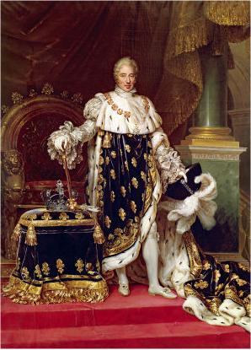
Charles X
Brother of Louis XVII
Last senior Bourbon to rule France
Rejected the Charter of 1814
Believer of Absolutism
Highly reactionary
Supporter of the old regime
Notes:
Charles X was the younger brother of Louis XVIII and the last Bourbon senior to rule France. He was a strong believer in absolutism and rejected the Charter of 1814, known as the Charter of the French Liberties, which was issued by Louis XVIII. He was highly reactionary and was a supporter of the old regime.

Slide 9
July Ordinances
1
Suspended the liberty of the press
2
Appointed new, and what many considered reactionary, Conseillers d'Etat
3
Dissolved the newly elected Chamber of Deputies of France
4
Reduced the number of deputies in future Chambers
5
Summoned new electoral colleges for September of that year
6
Withdrew the Deputies' right of amendment
7
Excluded the commercial bourgeoisie from future elections
Notes:
Compelled by what he felt to be a growing, manipulative radicalism in the elected government, Charles felt that as king by the right of birth and not parliamentary privilege, his primary duty was the guarantee of order and happiness in France and its people. The result was the July Ordinances, which he signed on July 25 while a guest in Saint-Claude. They were then published in the Parisian newspaper Moniteur the following day. These ordinances first suspended the liberty of the press, second Appointed new, and what many considered reactionary, Conseillers d'Etat, third Dissolved the newly elected Chamber of Deputies of France, fourth Reduced the number of deputies in future Chambers, fifth summoned new electoral colleges for September of that year, sixth withdrew the Deputies' right of amendment
, seventh excluded the commercial bourgeoisie from future elections.

Slide 10
July Revolution
Liberals + radicals responded forcefully
Angry citizens threw up barricades
July 1830
CHARLES X
1. suspended the legislature
2. limited the right to vote
3. restricted the press
Others fired soldiers and threw stones
The tricolor flew from Notre Dame
Charles went into exile in Britain
Charles X was forced to abdicate
He was succeeded by Louis-Philippe
Notes:
Liberals and radicals responded forcefully to the absolute king. In Paris, angry citizens threw up barricades across the narrow streets. Others fired the soldiers and throw stones and roof tiles. The revolutionary tricolor flew from the towers of Notre Dame Cathedral. Fighting continued for three days (July 27–29). Charles was forced to abdicate. He again went into exile in Britain. He was succeeded by his cousin, Louis-Philippe, son of the Duke of Orleans who had supported the French Revolution.

Slide 11
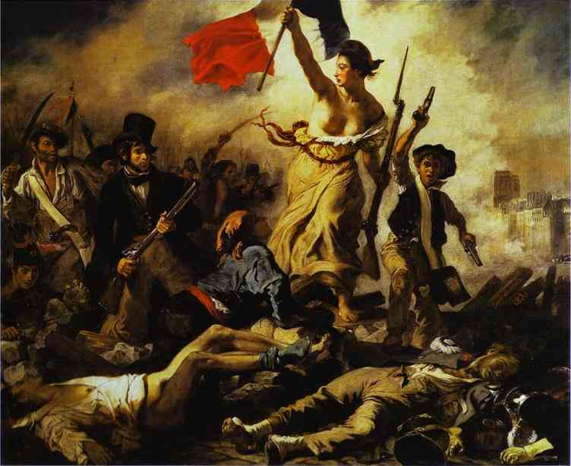
Liberty Leading the People
LADY LIBERTY
FLAG TRICOLOR
BOURGEOISIE
WORKING CLASS
Notes:
“Liberty Leading the People” was painted by Delacroix in celebration of the July Revolution. In this painting, liberty is portrayed as a strong, determined lady, leading the people with the tricolor flag of the revolution. It shows the struggle the people went through to fight for their country, and most importantly their liberty. All classes stood together for a mutual cause. The working class is represented by the boy on the right, while the Bourgeoisie is represented by the man on the left in the top hat.

Slide 12
Effects
Bourgeoisie secured a political and social ascendancy
Revolution of 1830
National Spirit throughout Europe
Notes:
In the July Revolution the bourgeoisie secured a political and social ascendancy that was to characterize the period known as the July Monarchy (1830–48).
On the other hand, the revolution of 1830 had other effects throughout Europe.
It raised National spirit in the countries like Belgium, Germany, Italy, Spain, Portugal and Poland. They led movements for achieving National Independence.

Slide 13
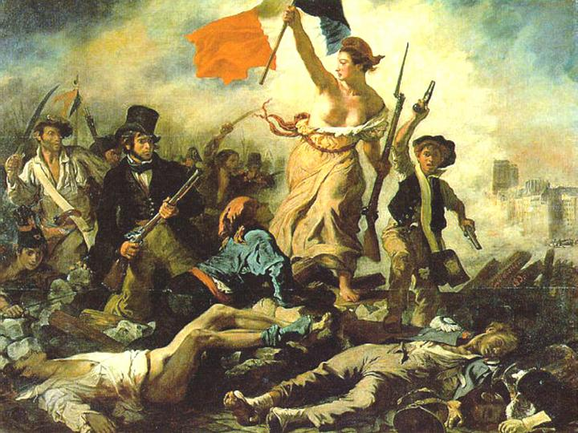
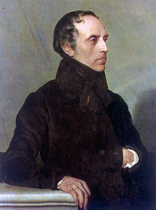
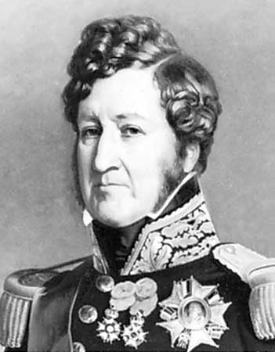
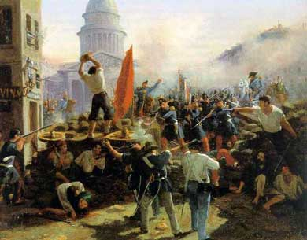
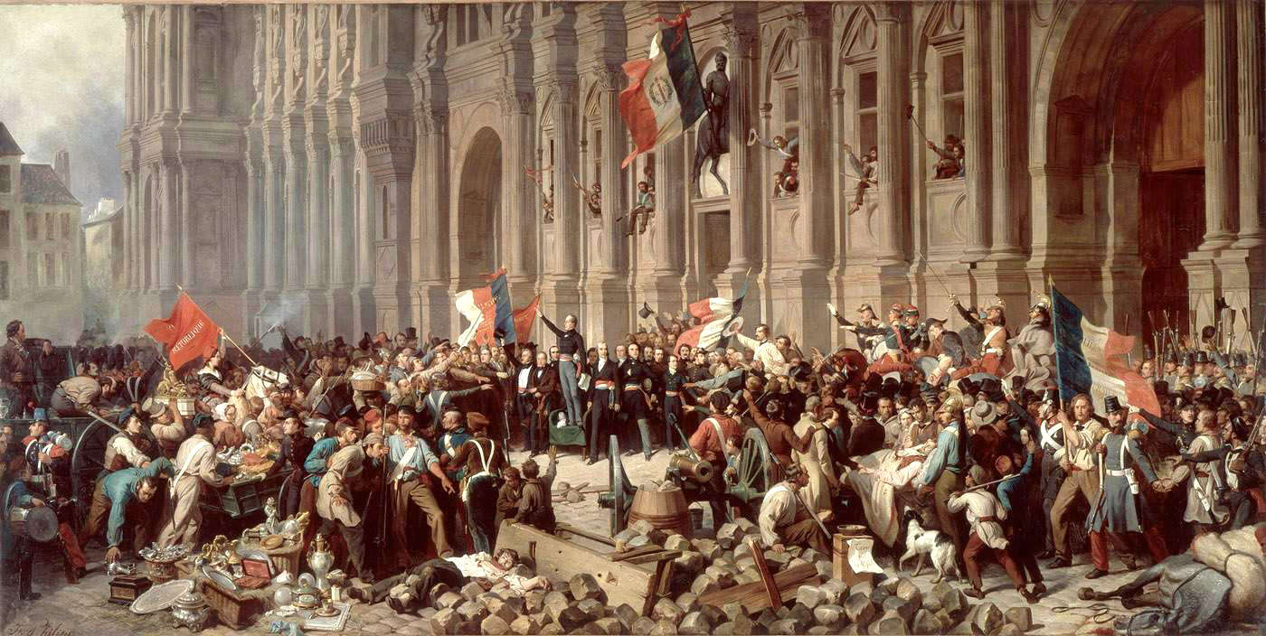
The Revolution of 1848
Notes:
The Revolution of 1848
- Alphonse Lamartine in front of building
- Louis Phillipe
- Francois Guizot

Slide 14
Causes
Industrialization
Population
Ideas of liberalism …
1846 – financial crisis and bad harvest
1847- economic depression
February Revolution
Notes:
The causes of the february revolution were :
1. Industrialization (economic challenges to rulers)
2. Increase in population leading to food shortage
3. Different Ideas of liberalism- democracy – socialism – nationalism
Then finally in 1846- financial crisis and bad harvest -> unemployment
1847 – economic depression

Slide 15
The February Revolution
Protests
Open Fire on protestors
No control over Paris
King abdicated on February 24
Political and reform banquets outlawed
Working class and liberals not happy with the king (Louis Philippe ) and his minister (Francois Guizot)
Notes:
The working class and the liberals were not happy with Louis Phillipe and his minister Francois Guizot. The political and reform banquets were outlawed. Then the protests started and Paris was out of control. Finally, the king abdicated on february 24 and fled to England.

Slide 16
The Second Republic
New political clubs
Goals :
1.Universal male suffrage
2. Unemployment ↓
(the national workshops)
President for 3 months
ALPHONSE de LAMARTINE
Notes:
The president almost a dictator of the Second Republic was Alphonse de Lamartine for 3 months. This new government had 2 main goals : the first goal was to have universal male suffrage and to decrease unemployment. Along with the second republic came new political clubs and the national workshops. The national workshop's idea was to grant everyone work and the “right to work” – Louis Blanc. It seemed successful at first then it did not work out as planned.

Slide 17
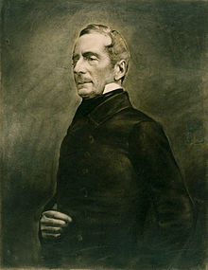
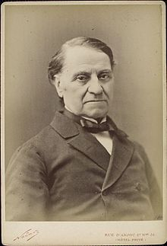
People that influenced the second republic:
- Louis Blanc
Politician and historian
- Alphonse Lamartine Writer, poet, and politician
Notes:
Two main people that had a large effect on the second republic were Louis Blanc and Alphonse Lamartine. Louis was a politician and historian best known for the national workshops. And Alphonse Lamartine was a writer, poet, and politician that ruled as a dictator for the first 3 months of the second republic.

Slide 18
Alphonse Lamartine
Believed in the “Rights of Man”
Met with Republican Deputies and journalists in the Hôtel de Ville to agree on the make-up of its provisional government.
Was chosen to formally declare the Republic in traditional form from the balcony of the Hôtel de Ville.
Notes:
- Believed in the rights of man which were to vote, to free speech, to property, and to the secular education
- Met with Republican Deputies and journalists in the Hôtel de Ville to agree on the make-up of its provisional government.
was chosen to formally declare the Republic in traditional form from the balcony of the Hôtel de Ville.
he took actions as a politician that eventually led to the abolition of slavery and the death penalty
He was an unsuccessful candidate to the presidential election of 10 December 1848, receiving fewer than 19,000 votes.
Then he retired from politics and dedicated himself to literature.

Slide 19
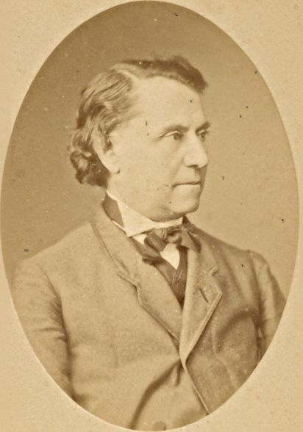
Louis Blanc
He was one of the two representatives for the workers.
Organizing Labor
“Right to Work”
Notes:
Louis Blanc was a social democrat that believed in the “Right to Work” within that would be the national workshops that provide work for the unemployed. These workshops failed to work since the National Assembly has taken them simply as a way to buy time. The workers and unemployed protested but were crushed. And Louis Blanc was blamed. Then people started to question his ideas and he lost a lot of support.

Slide 20
The Second Republic
Social tensions increased between the working class and the bourgeoisie middle class regarding (right to work- right to unionize – pay levels)
Disorganized → conservatives openly opposed the new government → using ‘order’ as their excuse which the new republic did lack
APRIL ELECTIONS
Notes:
The second republic had a couple of problems such as being disorganized which led to the conservatives opposing the new government and using the lack of order in the new government to their benefit. The social tensions also increased between the middle class and the working class regarding the right to work, the right to unionize, and the pay levels. Then the april elections brought new conflicts.

Slide 21
APRIL ELECTIONS
Conservative Majority
Debating fate of social programs
Removal of radicals
Notes:
The april elections resulted in a conservative majority in the National Assembly. This majority started debating the fate of social programs and they wanted the removal of the radicals like Louis Blanc . In early June the National Workshops were shut down therefore leading to more class tensions.

Slide 22
Government had betrayed revolution
Demand: redistribution of wealth
Result: new liberal and conservative coalition to oppose this lower class radicalism
Workers
Notes:
Then the workers said that the government had betrayed the revolution. They demanded for a redistribution of wealth. The result of this was a new liberal and conservative coalition to oppose this lower class radicalism.

Slide 23
REVOLTS

Slide 24
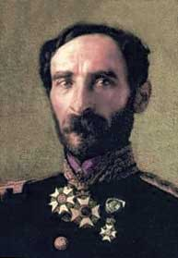
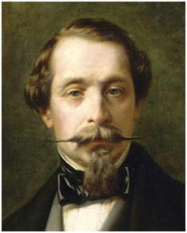
The 2nd French Republic
General Louis Cavaignac assumed power and crushed revolt
November 1848 – new constitution
President Louis Napoleon
Notes:
General Louis Cavaignac assumed power and crushed the revolt 10,000 people died. Then in November 1848 – a new constitution was written where there will be an elected president and a one – house legislature. And the first . president was Louis Napoleon.

Slide 25
THANK YOU

