Slide 1
Brief summary on current situation
Regime’s eagerness for wealth and poverty are two main problems
The people blew up and formed a revolution on January 25, 2011
It was the spark that led to the fire
Mubarak stepped down on February 11, 2012
The country is suffering instability since with the rule of the SCAF(Supreme Council of Armed Forces)

Slide 2
Egypt: The era of Mubarak(Three decades of reign)
By: Hussein, mounzer, nadim, and youssef

Slide 3
Early life/BACKGROUND
Mubarak and wife Suzanne have two Children Gamal and Alaa
Graduated from the National Military Academy in 1949.
Received a Bachelors Degree in Military Science.
Left the Military Academy and joined the Air Force Academy.
Served as a Splitfire Fighter for 2 years.
In 1950-1959, Mubarak trained in the Soviet Union.
Trained in a pilot training school in Moscow and another in Bishkek.

Slide 4
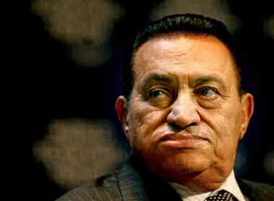

Slide 5
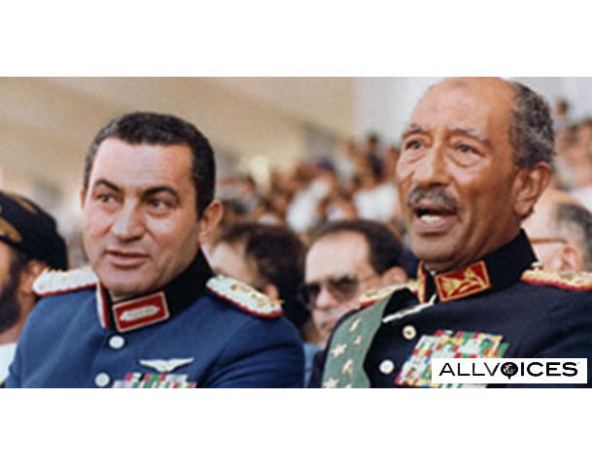
Sadat assassination and Mubarak as president
People approved vice president Mubarak and he became Egypt’s fourth president in October 14, 1981
Mubarak continues Sadat’s way of rule

Slide 6
Early years of rule
Fought political Islamic groups such as Muslim brotherhood
Jailed over 2500 of Islamic group activists
Continued most of Sadat’s foreign and domestic policies such as Camp David Peace treaty with Israel and relations with the USA
Increased production of affordable housing, medicine, food, and clothes
Was firm in taking actions and giving consequences
Fired ministers that weren’t capable of fulfilling their quests and fined members of parliament that had unnecessary absences

Slide 7
Tried to pressure Israel to approve Palestinian settlement with the aid of the USA
Improved relations with, the former allies, the Soviet Union

Slide 8
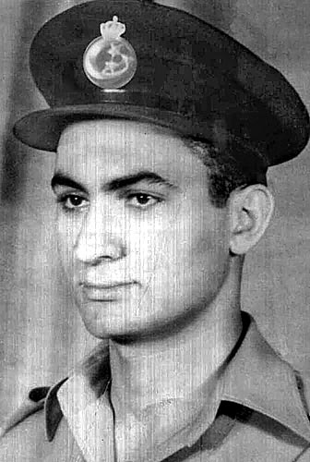

Slide 9
Relationships with Israel and the usa
Egypt has been receiving financial aid from the US and it reached a debt of $18 billion by 1990
Egypt tried to lessen the debt by the government increased the prices of taxes, gasoline , electricity, and food
The people were upset from the raise of prices but couldn’t do anything due to the power of the authorization
Tried to solve Israeli/Palestinian settlement problem

Slide 10
Foreign aid
1/3 of all US aid goes to Israel and Egypt
Obama and Congress approved $1.3 billion military aid and $250 million in economic aid
Only 26% of Egyptians favor US economic aid to Egypt
If the US stops giving aid to Egypt, violation of Camp David accords
Foreign debt is $34.4 billion
US military aid is 25% of Egypt’s defense spending per year

Slide 11
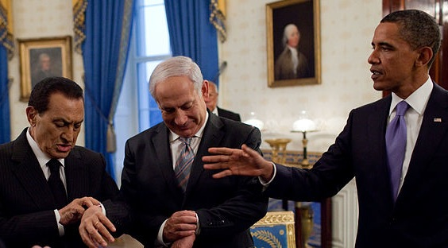
Defense budget is $4.56 billion in 2010
Ranking 3rd after Israel and Saudi Arabia

Slide 12
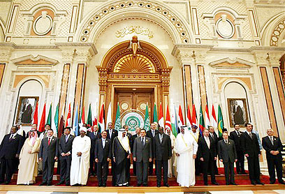
Arab league
1n 1989, Mubarak led Egypt into being re-admitted in to the Arab League
Headquarters were located to Cairo
Egypt played a huge role in the Arab League by encouraging peace between Arab nations
Negotiate as Arabs to find solutions for the Israeli-Palestinian settlement

Slide 13
Economy
Egypt’s economic situation became critical in 1990 due to the Persian Gulf crisis
bartered agreements that eliminated the need to expand foreign currency
Relations between Egypt and the Soviet Union increased, there was a $5 billion trading deal between both nations in 1990
Egypt faced a major economic downfall in the late 1980s and 1990s

Slide 14
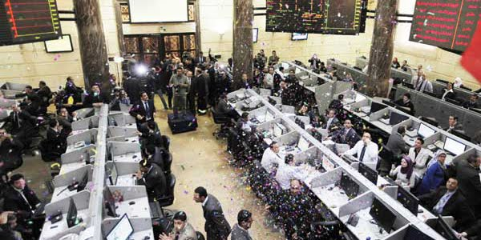
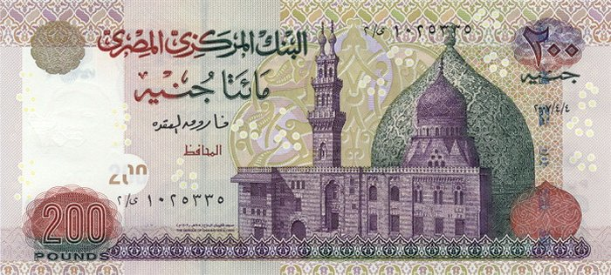

Slide 15
Negative economic growth and heavy indebtedness
In October 1990, the Egyptian government agreed to reschedule its $18 billion debt to the Paris Club(18 Western creditor nations)
The government, therefore, increased gas, fuel, oil, electricity, flour, and wheat prices in order to profit
Domestic banks’ interest rates increased
Established industrial free zones to promote new investments and create more jobs
Rising inflation was a major problem that the country has faced

Slide 16
Income usually came from Suez Canal tolls and tourism
New appointed government led by Ahmed Nazif in 2004 caused more economic problems
Increase in prices was continuous

Slide 17
Government
Under Mubarak’s rule, acquired more authority than they should
Mixed presidential-parliamentary cabinet system
People Assembly(elected upper house) and Consultative Council(lower house)
National Democratic Party was the dominant party
Muslim Brotherhood was the #1 opposition force

Slide 18
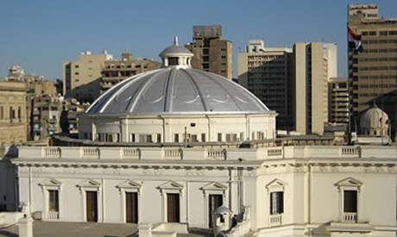
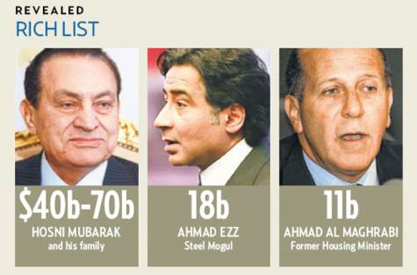
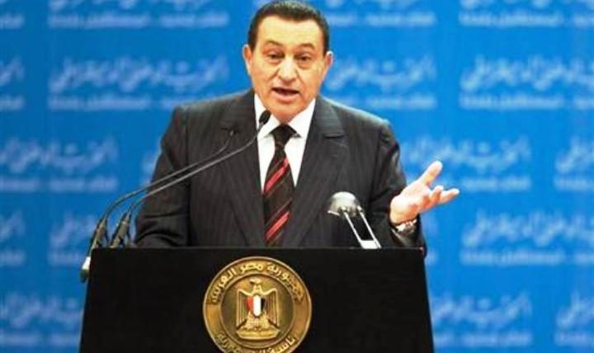

Slide 19
Emergency Law
Police powers are extended
Constitutional rights suspended
Any movements/demonstrations against authority are banned
Government has the right to imprison any individual at any time for no reason

Slide 20
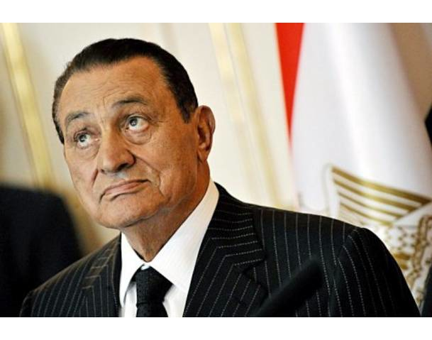
Judges tended to defend people against the state, but the Interior ministry ignored the presses
Mubarak followed policy of gradualism

Slide 21
State corruption
Imprisonment of young activists and political figures
Emergency law
Officers could violate citizens’ privacies in their own areas
State ownership of most economic levers
Massive gap between classes/squeezed middle class
Transparency International Corruption Perceptions Index(CPI) gave Egypt rating of 3.1

Slide 22
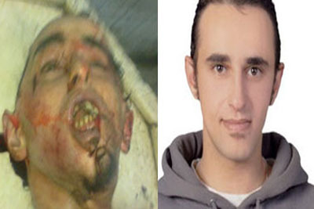

Slide 23
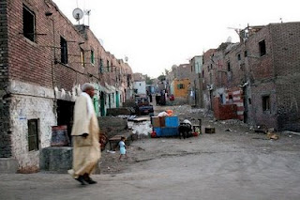
EXTREME LEVEL OF POVERTY
About 20% of Egyptians are below the poverty line
Poor occupied in marginal activities
Low wage and high unemployment rates
North of Egypt more prosperous
High level of malnourishment of children

Slide 24
Revolution
Protests started on Tuesday, January 25, and was inspired by the successful revolution in Tunisia.
Several people setting themselves on fire due to the impoverished living circumstances triggered the revolts
Thousands of people started to protest poverty, unemployment, government corruption and autocratic governance of President Hosni Mubarak

Slide 25
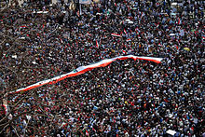
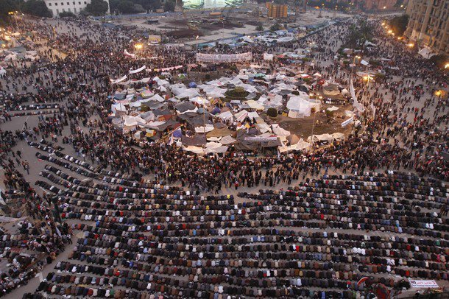

Slide 26
Protests
Youth started the movement
Political figures such as Mohamed ElBaradei gave them support
Mubarak gave speech saying that he will not run for presidency for another term
People continued protesting and violence increased(hundreds of deaths)
VP Omar Suleiman announced that Mubarak resigned on February 11, 2011 giving SCAF the authority to rule

Slide 27
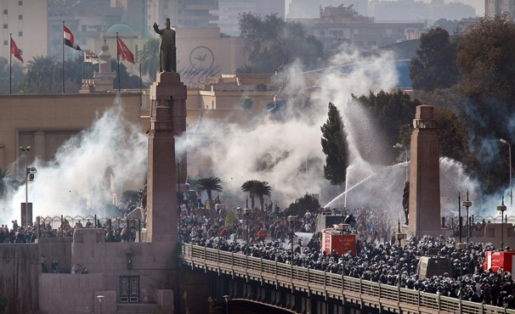
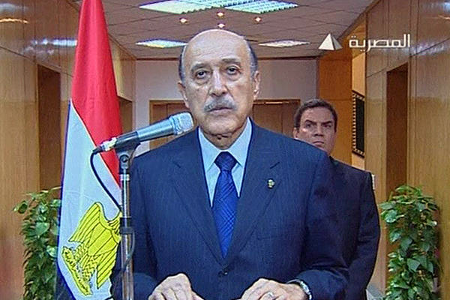
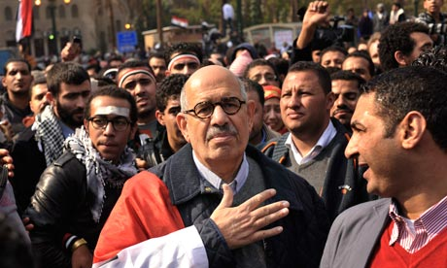

Slide 28
Clashes between police and protesters
Tear gases used to separate protesters
Police withdrew on January 28, 2011
Burglars and thugs escaped from prisons and attacked residents’ properties
“Battle of the Camel” on February 2, 2011 caused many deaths

Slide 29
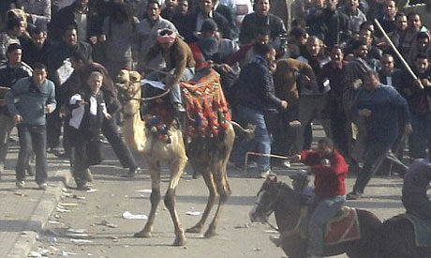
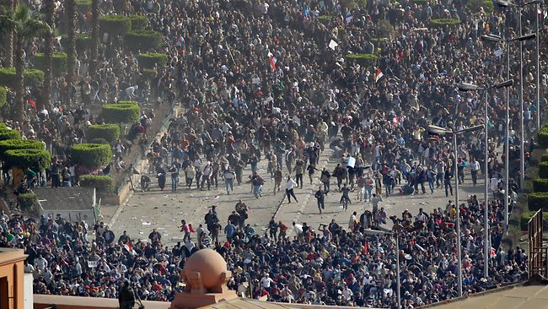

Slide 30
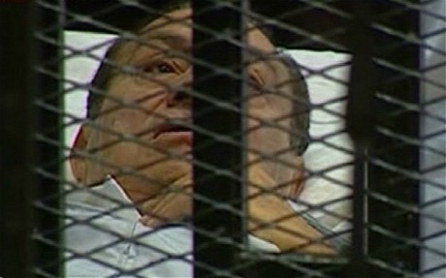
Trials
Members of old regime got arrested including former President and family
Trials are continuing till now
Judges adjourning verdict till full evidence shows up
Witnesses are called up
Former president in bad health condition

Slide 31
Clashes with military
Military slow decisions and movements jaded the people
People protested to demand rights
Military denied attacks and claimed that no violence happened from any soldier
Many deaths later on happened in events such as protests in Maspiro, Interior Ministry, and Tahrir Square

Slide 32
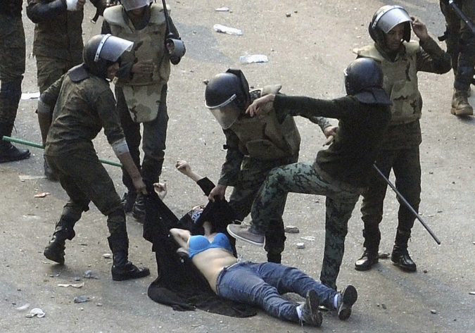
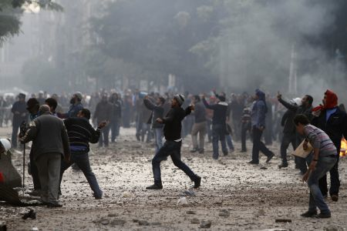
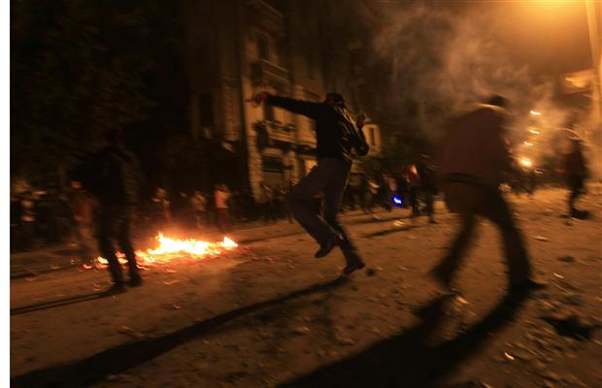

Slide 33
Recently
Egyptian people had the right to vote for first time
National Assembly formed
Consists mostly of Muslim Brotherhood party(50%)
El Noor party(Islamic force) forms 25%
The other 25% is formed by liberals, youth, and the Egyptian Alliance
Consultative council elections are being held now

Slide 34
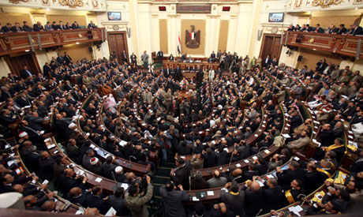
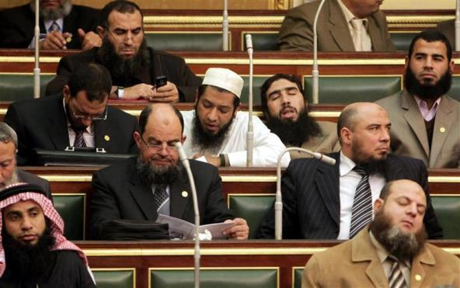
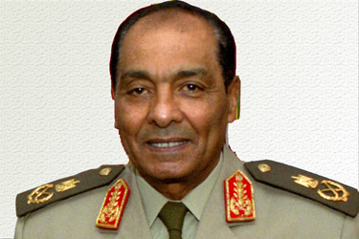

Slide 35
People protesting again
Insisting that SCAF leave authority and start presidential elections as soon as possible
SCAF stated that elections to be in April
Disaster in soccer match in Portsaid added fuel to the fire
Caused 74 deaths
Egyptian FA were removed and asked to explain the dreadful event

Slide 36
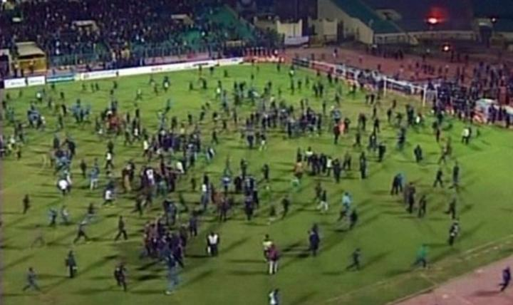

Slide 37
National Assembly is trying to find solutions
Preparations for presidential elections
People claim that before anything happens there has to be strict actions against the ones responsible for deaths
Protests continue every day especially each Friday

Slide 38
